Slide 1
REPAIR AND RESTORATION
of the North Pelham Easement August-Dec. 31, 2018

Slide 2
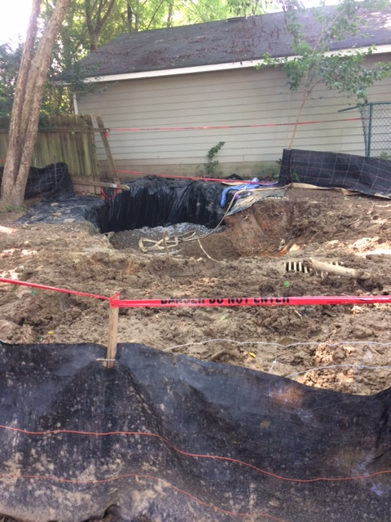
August 23 2018
Filling in sinkhole underneath broken pipe to provide support for pipe.

Slide 3
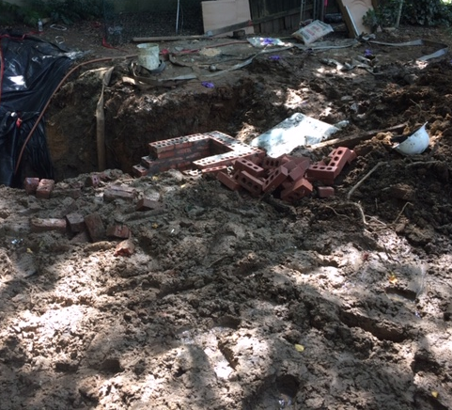
Aug 28, 2018
Rebuilding storm drains.

Slide 4
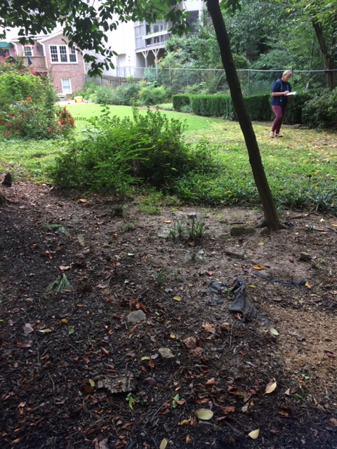
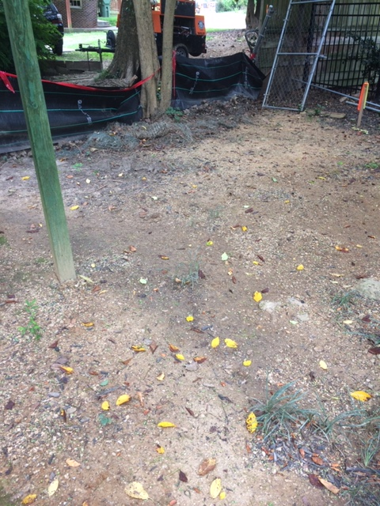
Aug. 29, 2018
Landscape contractor assesses damage caused by flooding of easement.
Closer look at where sod and liriope have washed away.

Slide 5
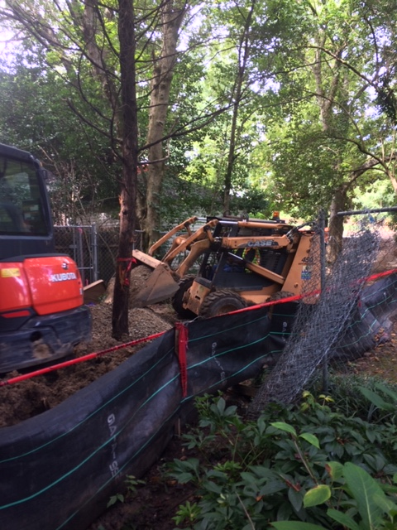
Aug. 30, 2018
Heavy machinery clears channel to storm drain.

Slide 6
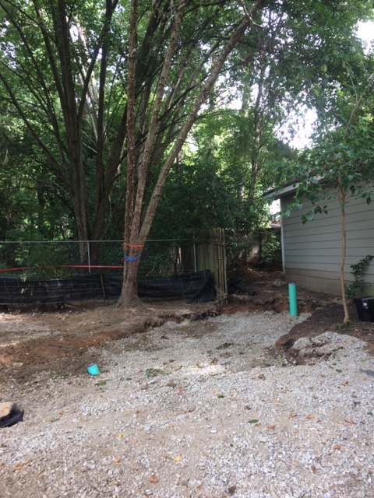
Sept. 6, 2018
Sinkhole, now with pipe repaired and hole filled in, is capped.

Slide 7
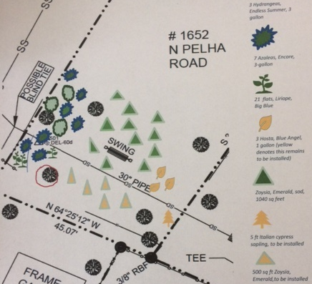
Sept. 10, 2018
Plan for restoring plants damaged by flooded easement is submitted.

Slide 8
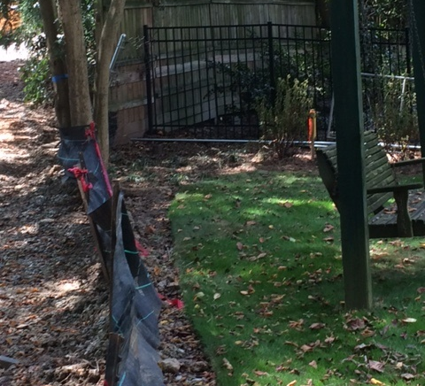
Sept. 12, 2018
Sod and plants that had been damaged are replaced

Slide 9
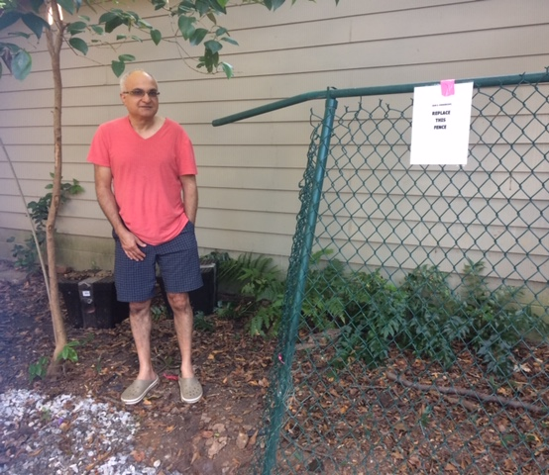
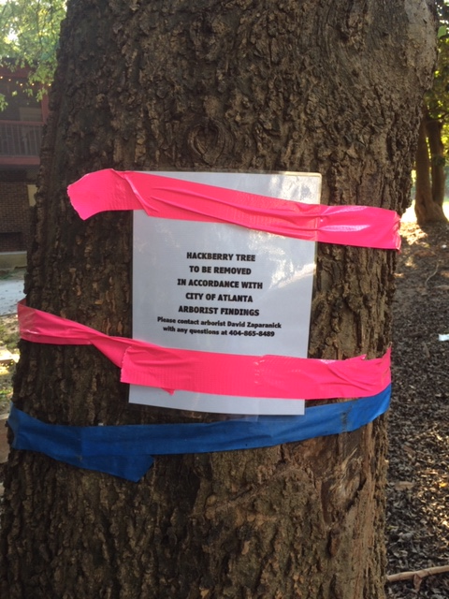
Oct. 5, 2018
Second meeting with owners of property adjacent to easement. This time, owners identify damaged fence, express expectations, and trees deemed damaged are marked for the city arborist so that the tree removal contractor is sure to remove the right ones.

Slide 10
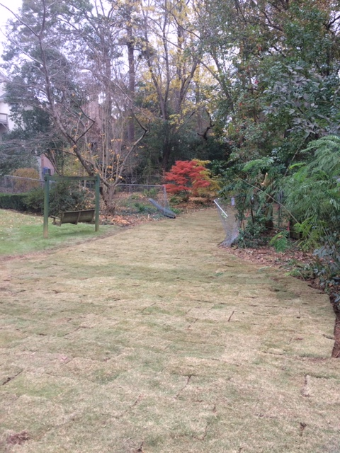
Nov. 30, 2018
Sod is installed.

Slide 11
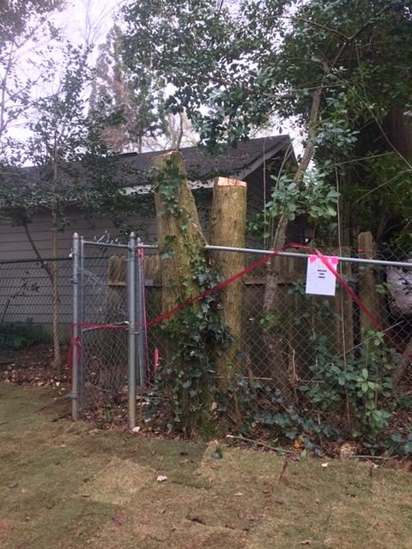
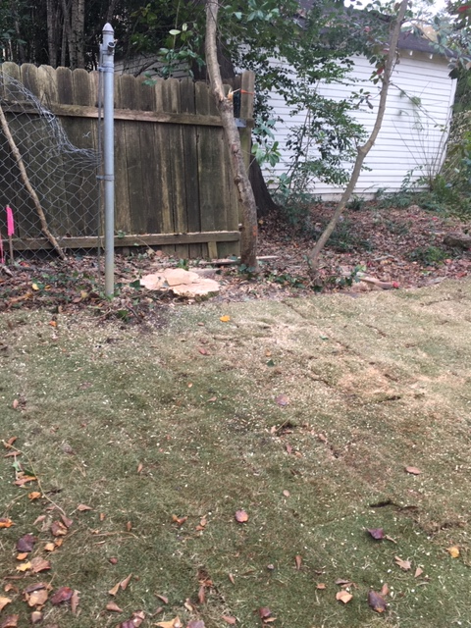
Dec. 4, 2018
But, oops, the tree surgeon left a tree that had been marked for removal, which meant the damaged fence it was growing through couldn’t be removed, either.
This was AFTER the sod had been put in.
So, the tree contractor agreed to take the tree apart a piece at a time and walk it out.

Slide 12
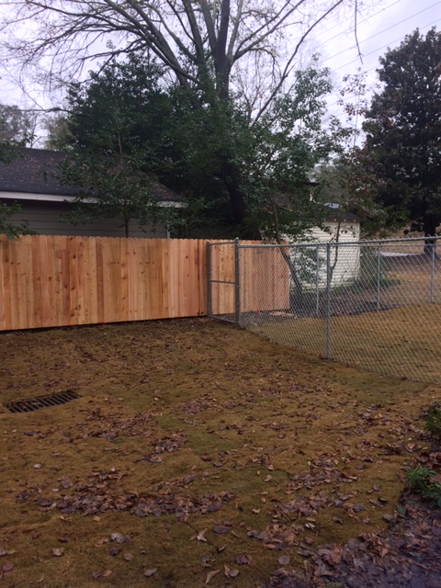
Dec. 31, 2018
The damaged fences are replaced.
The project is completed ahead of the Jan. 4 deadline .

